Slide 1
COST FinAI annual meeting
UKRAINE: Update, 2024

Slide 2
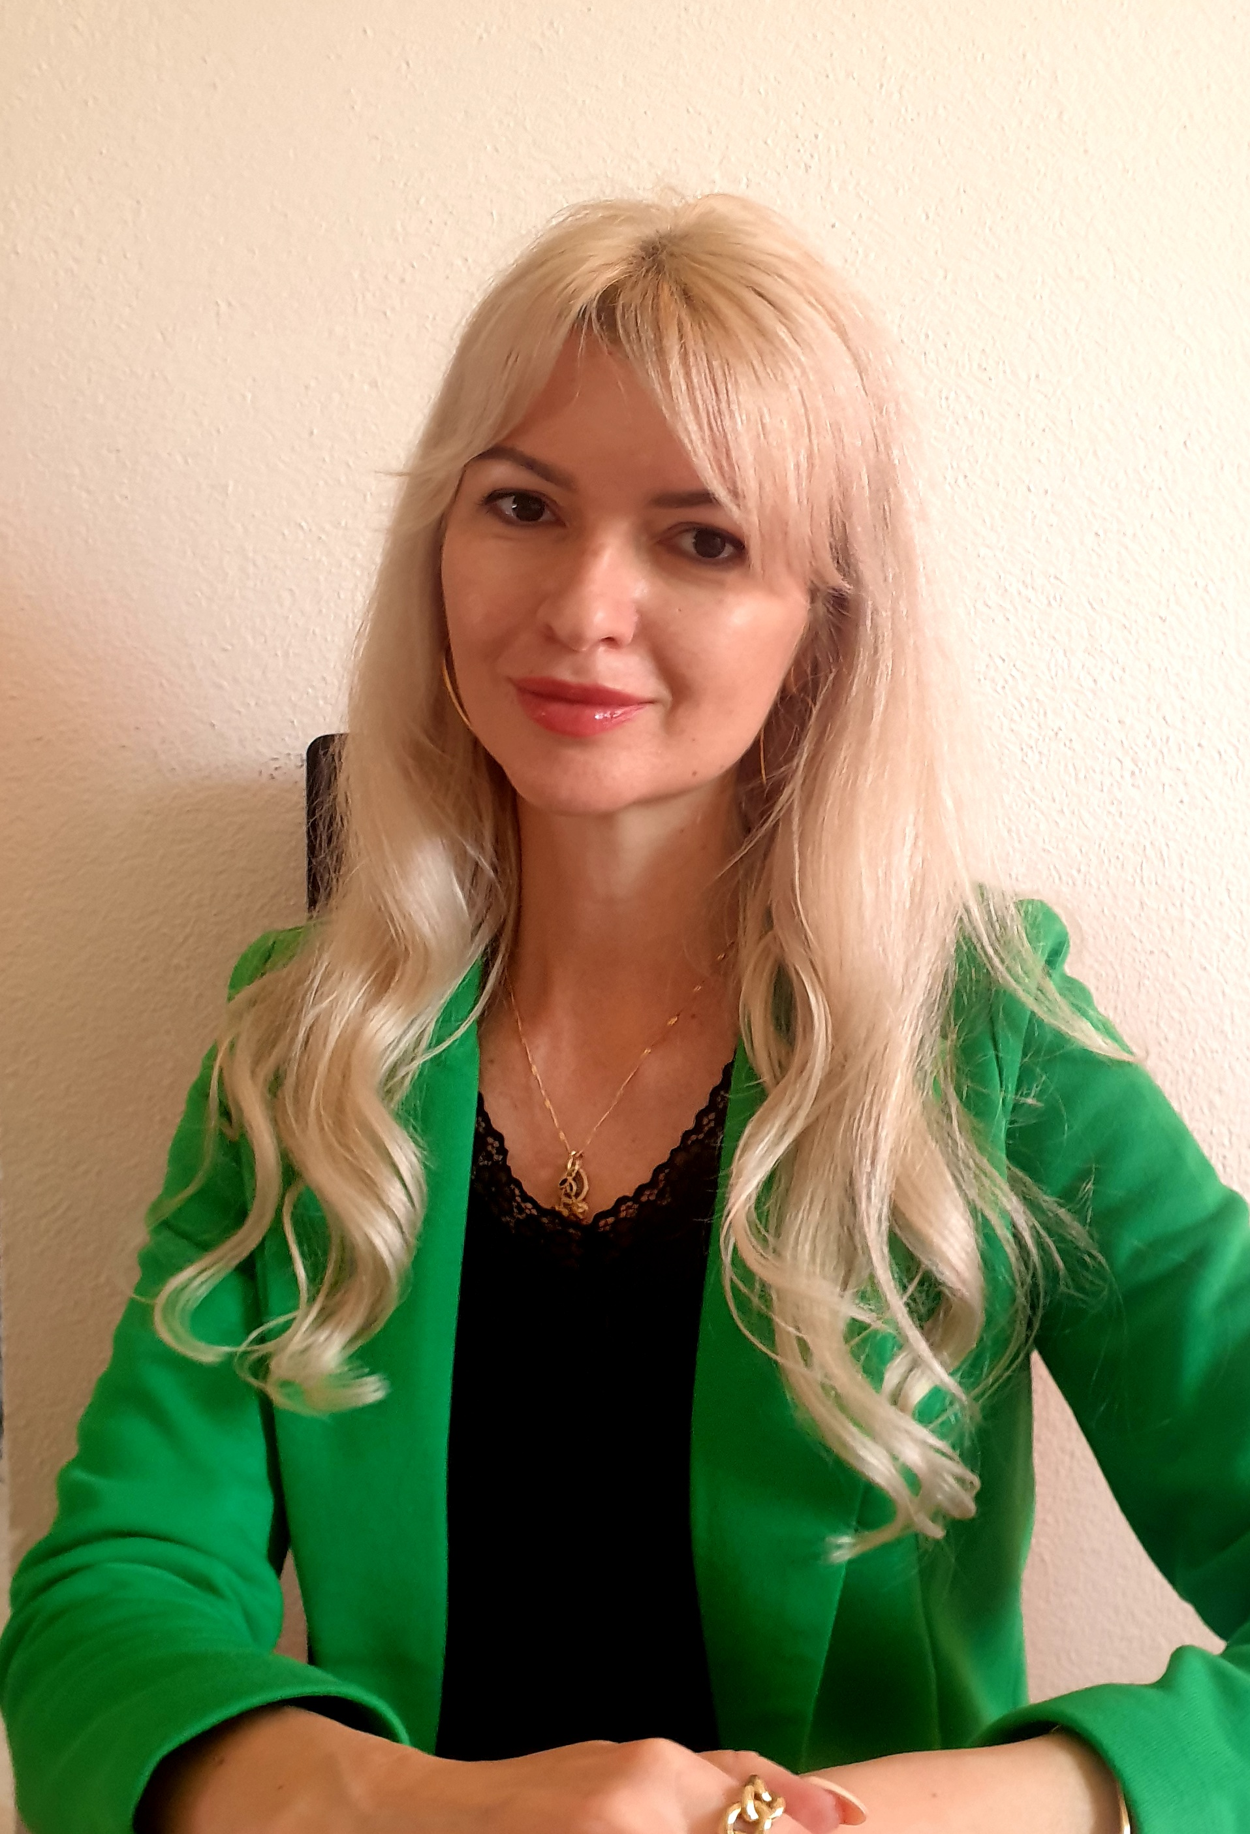
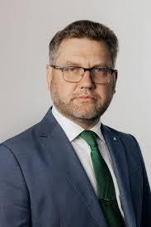

Representation
Ukraine’s Management Committee
Alona Klochko (SNAU)
Prof. of International Relations Chair, Law Faculty of Sumy National Agrarian University (SNAU, Sumy, Ukraine)
Visiting Prof., Scientific Collaborator of the Chair of Criminal Law and Procedure, Law Faculty of the University of Neuchatel (UniNE, Switzerland)
alenaklocko@gmail.com
MC substitute
Yurii Danko (SNAU)
Vice Rector for Scientific and International Work, SNAU
Doctor of Economic Sciences, Professor
y.danko@snau.edu.ua
Nataliia Volchenko (SNAU)
the head of the International Relations Chair, Law Faculty of SNAU,
Phd at Economics, Associate Prof.
natavol4enko@gmail.com
Interdisciplinary background : International Law, AI Legal Regulation, Economics

Slide 3
Recent Contribution:
Klochko A. Improvement of the legislation of Ukraine regarding the regulation of AI technologies in the banking sphere in the conditions of European integration. Section in the collective monograph on the topic: The Modern Paradigm of Public and Private Law in the Conditions of Sustainable Development“. ISMA University of Applied Sciences, Sumy National Agrarian University, 2023
Klochko A.M., Zelenskyi O.M. Exploring the capacity of AI technologies to combat corruption. Юридичний науковий електронний журнал. № 2/2024 P. 493-497. DOI https://doi.org/10.32782/2524-0374/2024-2/122.
Klochko A, Kurylo M, Rohovenko O, et al. (2024). The legal regulation of artificial intelligence security in Ukrainian banking. Journal of Infrastructure, Policy and Development. 8(2): 2582. https://doi.org/10.24294/jipd.v8i2.25 82. URL: https://systems.enpress-publisher.com/index.php/jipd/article/view/2582/2129

Slide 4
Contribution:
Phd student supervision and defense of the thesis by the Phd student (December, 2023):
Bolotina A.O. Criminal protection of intellectual property rights in the context of judicial reform in Ukraine. Qualifying scientific work on manuscript rights. Dissertation for obtaining the degree of Doctor of Philosophy in the specialty 081 «Law» in the field of knowledge 08 «Law». Sumy National Agrarian University, Sumy, 2023.
Key words: intellectual property, criminal law protection, criminal offense against intellectual property, sustainable development, judicial reform, Supreme Court on Intellectual Property, judicial protection, criminal legislation reform, objects of intellectual property, subjects of intellectual property, right for the fair trial, artificial intelligence.
Separate findings of the dissertation contain the results concerning defining the copyrights for works
created by AI and the draft criminal norms of the acts committed by abuse of AI.

Slide 5
SNSF Advanced Grant, 2024
Title: Utilizing Artificial Intelligence to Safeguard Against Corruption: A Case Study in Ukraine with Global Implications. PI: Prof. Alona KLochko with the commitment letter from the UniNE.
Project applications:

Slide 6
Conference: «ChatGPT, Large Language Models and Law» (July, 3, 2023)
Organized by LexTech Institute. Aula of the Faculty of Law 1st floor, Av. du 1er-Mars 26, 2000 Neuchâtel
Discussed subjects: the latest breakthroughs in Artificial Intelligence (AI) with one of the foremost authorities in the field, Professor Harry Surden.
EVENTS PARTICIPATION:

Slide 7
“AI Legal Regulation” for the law students of Sumy National Agraraian University. Master’s degree program.
Course development:

